Slide 1
The 3GPP Submission
Source: RAN ITU-R Ad-hoc Convenor

Slide 2

3GPP System
  3GPP aims to the definition of a full system (Radio and Core Network)
  3GPP specifications will be labelled “5G” from Release 15 onwards
  5G requirements
    Service: TS 22.261 “Service requirements for next generation new services and markets”
    Radio: TR 38.913 “Study on scenarios and requirements for next generation access technologies”
  Overall architecture (expected Dec 2017):
  TS 23.501: “System Architecture for the 5G System; Stage 2”
  TS 23.502: “Procedures for the 5G System; Stage 2”
  RAN aspects
    TR 38.901: “Study on channel model for frequencies from 0.5 to 100 GHz”
    TR 38.912: “Study on new radio access technology”
    Technical specifications will be captured in the 36, 37 and 38 series

Slide 3
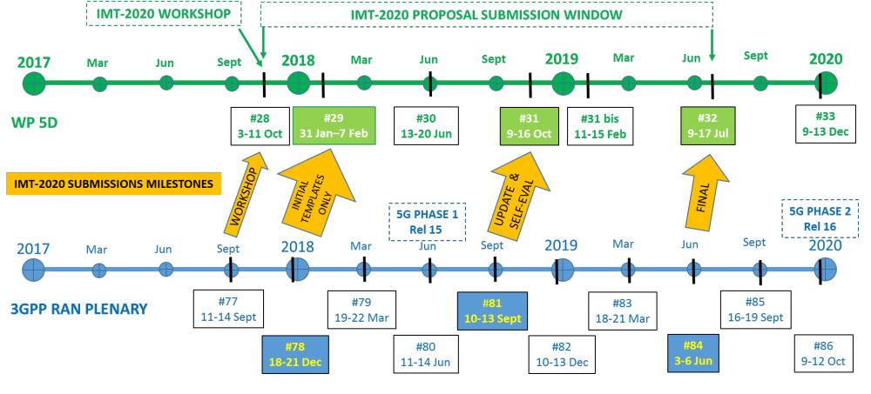
IMT-2020 submission - timeplan
NOW
From RP-172098

Slide 4
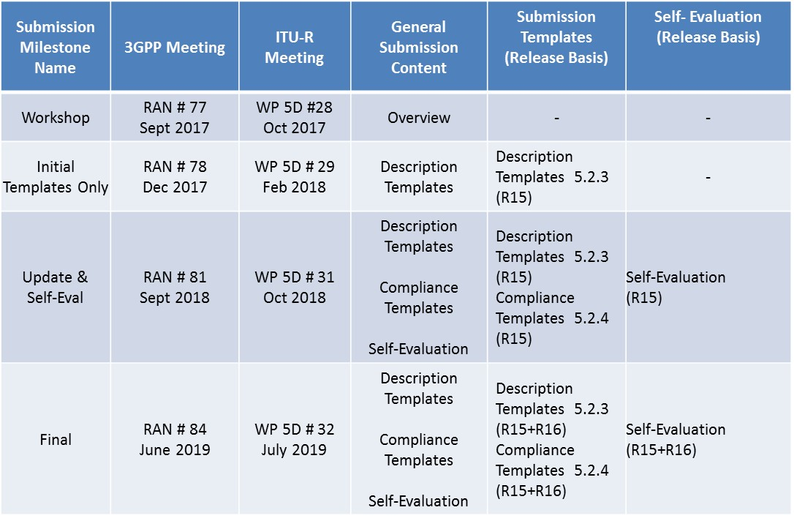
IMT-2020 submission - timeplan
From RP-172098

Slide 5
IMT-2020 submission format
Submission 1
  SRIT
    Component RIT: NR (*)
    Component RIT: EUTRA/LTE
      incl. standalone LTE, NB-IoT, eMTC, and LTE-NR DC
    full 38 and 36 series, and subset of 37 series
Submission 2 (In addition to the above)
  NR RIT (*)
Naming
  Name : 5G
  Footnote: Developed by 3GPP as 5G, Release 15 and beyond
(*) The plan is to leverage the NR RIT (in submission 2) as the NR component RIT in submission 1; NR details TBD
From RP-172098

Slide 6
Where are we now?
3GPP approved an updated submission in October based on 3GPP Release 15
This Submission is not final. Therefore, it will be updated on the basis of 3GPP workplan and the Final submission will be delivered according to WP5D timeplan

Slide 7
Preliminary Description Template and Self-Evaluation of 3GPP 5G candidate
This document allows the Independent Evaluation Groups to familiarise with the 3GPP 5G solution for IMT-2020 and to prepare the evaluation activity
The updated description of 3GPP 5G and initial self evaluation can be found in PCG41_08 and provides
  characteristics template for SRIT and NR RIT
  compliance template for SRIT and NR RIT
  link budget
  preliminary self evaluation report (TR37.910 V1.0.0)

Slide 8
Thank you!

